Slide 1

Stock Price Prediction of TATA using Machine Learning
Data Preprocessing, Linear Regression, and Prediction
Team: Rakesh, RamCharan, Mahesh, Ganesh, and Harsha

Slide 2

Project Objective & Importance
Our Mission
Predict TATA stock's closing price using historical market data and machine learning techniques for accurate financial forecasting.
Why This Matters
Enhanced investment decision-making
Risk assessment and portfolio optimization
Market trend analysis and insights

Slide 3




Technology Stack
Python
Pandas & NumPy
Core programming language for data analysis and model development
Data manipulation, cleaning, and numerical computations
Matplotlib
Scikit-learn
Data visualization and plotting historical stock trends
Machine learning algorithms and model evaluation tools

Slide 4
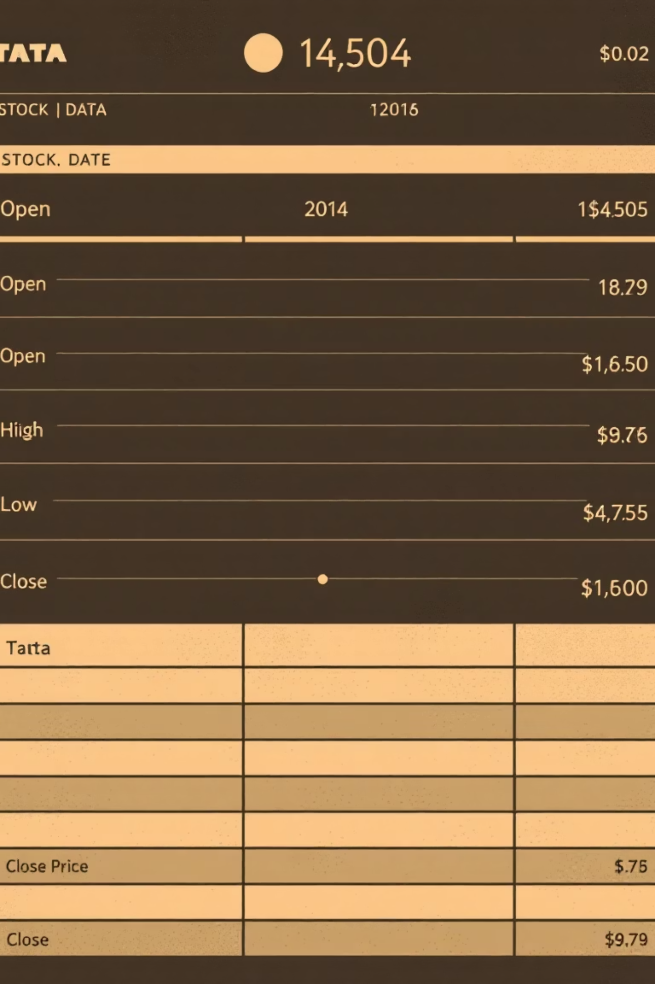
Dataset Overview
Data Source
Key Columns
TATA.xlsx - Historical stock market data with comprehensive trading information
Date, Open Price, High Price, Low Price, Close Price, Trading Volume
Data Challenges
Missing values in numeric columns requiring preprocessing

Slide 5
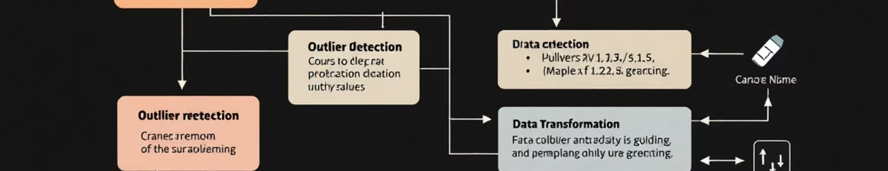
Data Preprocessing Pipeline
01
02
03
Missing Value Treatment
Date Conversion
Data Splitting
Applied linear interpolation to fill gaps in numeric columns, ensuring data continuity
Transformed date column into Excel serial format for numerical regression modeling
Divided dataset into training and testing sets for model validation

Slide 6


Machine Learning Model Configuration
Model Specifications
Algorithm: Linear Regression
Feature: Date (serial number)
Target Variable: Close Price
Training Split: 80% training data
Testing Split: 20% validation data
Linear regression establishes a mathematical relationship between time and stock price movements

Slide 7




Model Implementation & Evaluation
Model Training
Trained Linear Regression on processed historical TATA stock dataset
Performance Evaluation
Assessed accuracy using Mean Absolute Error (MAE) metric
Prediction Interface
Users input future date (YYYY-MM-DD format) to predict closing price

Slide 8

Results & Prediction Demonstration
Model Performance
Successfully achieved reliable stock price forecasting with measurable MAE accuracy
Prediction Example
Input any future date to receive predicted TATA closing price with confidence intervals

Slide 9
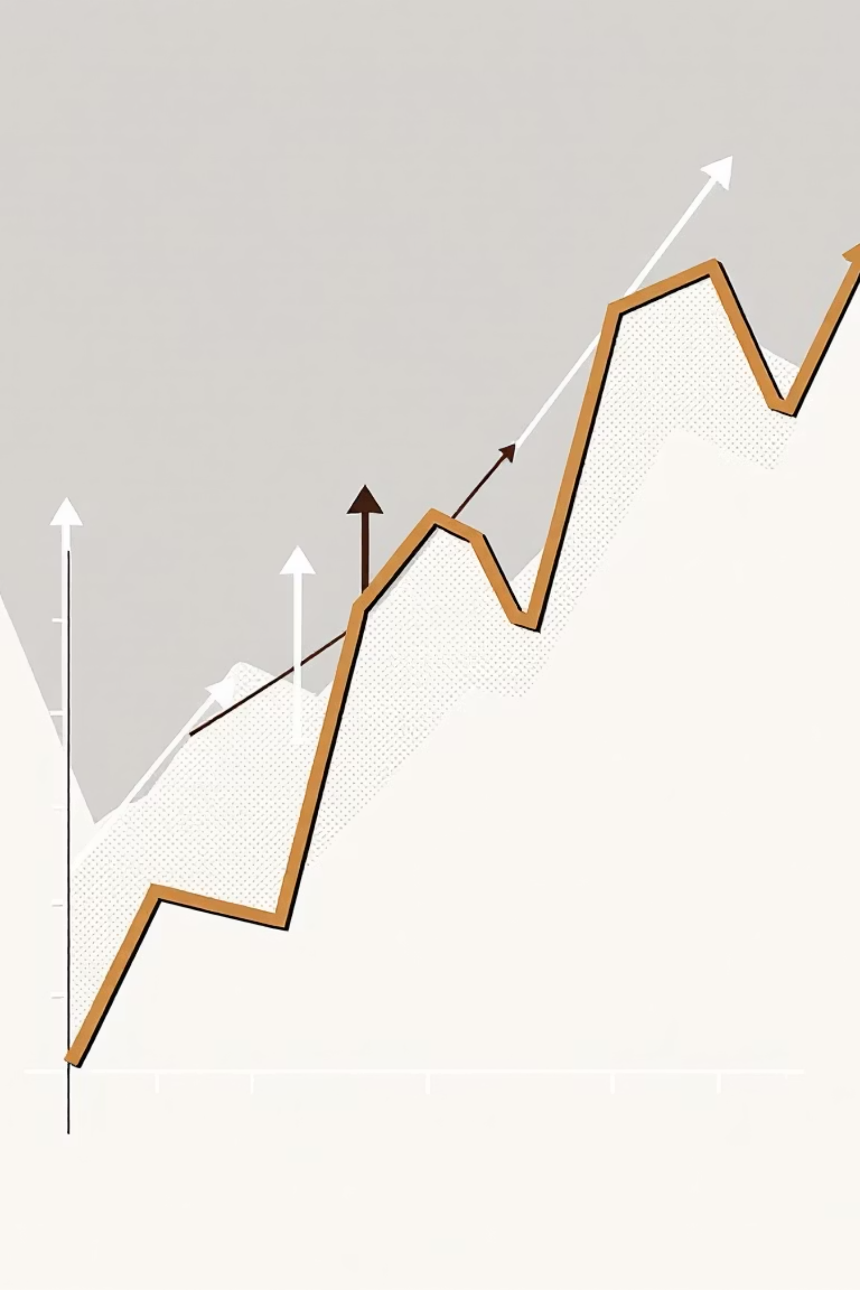
Data Visualization
Historical Trend Analysis
Comprehensive line plot displaying TATA stock closing prices across the entire time period
Prediction Visualization
Red marker highlights predicted price point against historical blue trend line

Slide 10

Conclusion & Future Enhancements
Key Achievements
Successfully implemented stock price forecasting
Demonstrated Linear Regression effectiveness
Created user-friendly prediction interface
Limitations
Linear regression may not capture complex market volatility patterns
Thank you for your attention!
GitHub repository: Available for code review and collaboration

